Slide 1

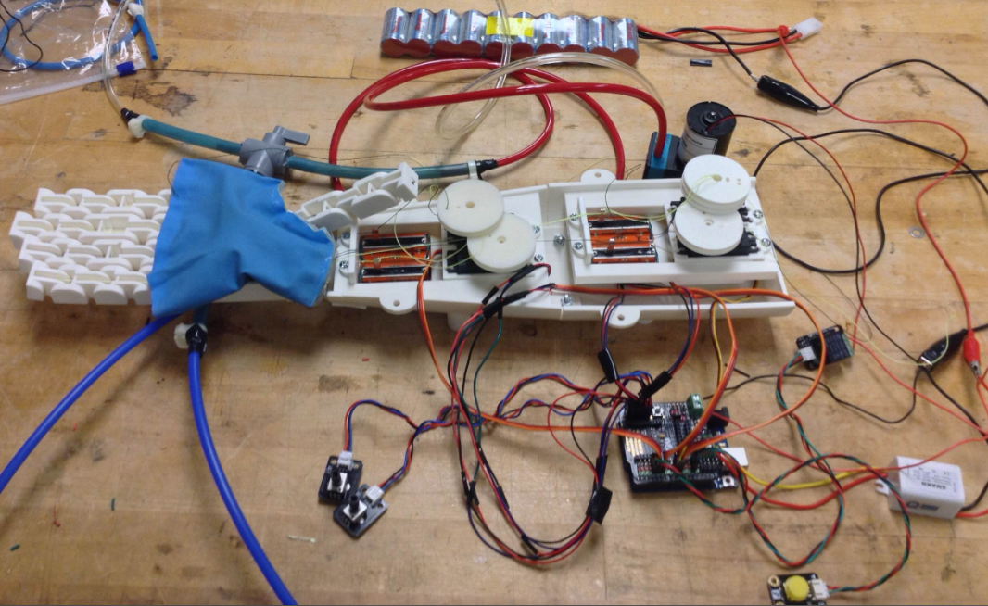
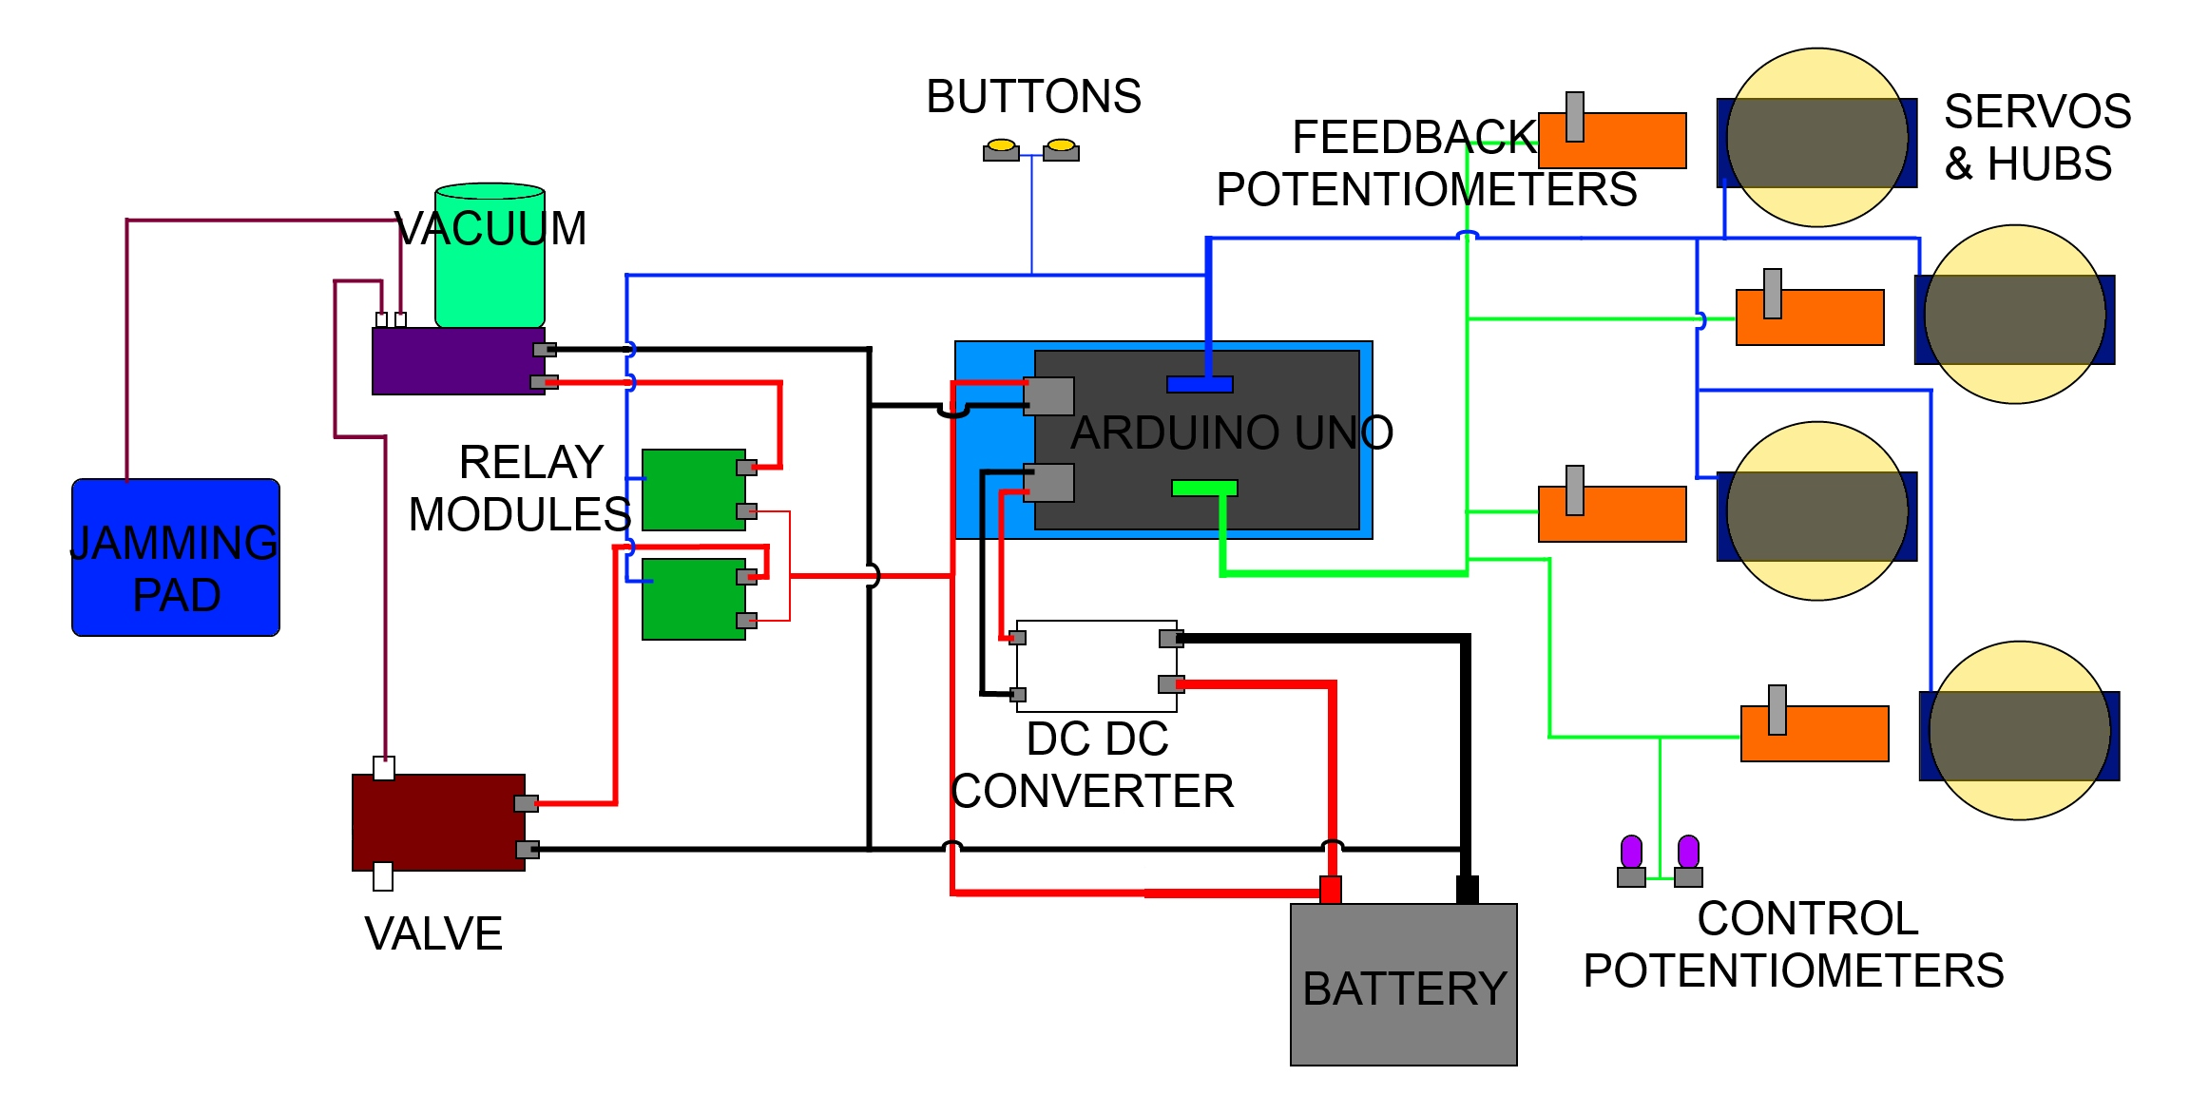
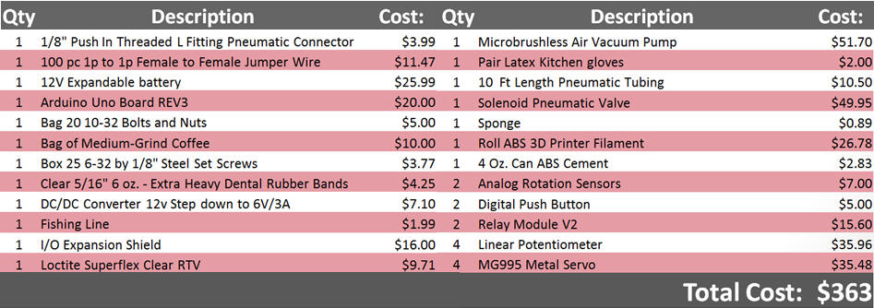

3D Printed Granular Jamming Hand
Melissa Indoe, Seoungwoo Kang, Sean Phelan, Maggie Serra, Christopher Wallace
Advisor: Robert C. Chang, Junior Advisor: Jennifer Field
INTRODUCTION
PROTOTYPE
DESIGN OVERVIEW
Background
Currently there are about three million people worldwide with arm amputations , fifty-nine percent of which are below the elbow, and more happen every year. Current prosthetic hands are costly and only half of amputees even get access to them. Therefore, there is a clear need for an affordable, readily available prosthesis.
Project Objective
The objective of the project is to create an open-source, high-functioning, affordable (under $500), prosthetic hand. The prosthesis is task-oriented and able to perform simple activities requiring low strength and high dexterity. It is of similar size and weight to an average human hand, and is designed for a patient who has lost an arm below the elbow.
The hand is designed to require very few tools to put together. It is almost entirely 3D printed and requires very little assembly, making it simple for the layperson to manufacture. Through the use of open-source software, inexpensive materials, and simple assembly, this design allows users to make modifications to the prosthesis. Ultimately, it may be used as a prosthesis, a model, or a development platform.
Bill of Materials
Actuation
Each finger has fishing line that runs from the fingertip to a servo in the forearm. As the servo rotates, the line is contracted and pulls the finger towards the palm. This motion mimics how an actual finger moves via tendons.
Granular Jamming
Granular jamming is a concept in which coarse granules (coffee grounds are the best) are placed in a flexible casing, pressed onto an object, and then all of the air is removed from the casing to create a rigid gripper. Once air is allowed back into the casing, the object is released. This design is used on the palm of the hand to add functionality.
Control
Servo positions are controlled by a rotary potentiometer by sending commands to the Arduino. As the servo moves, it gets feedback from a linear potentiometer. If the linear potentiometer position has not updated, the program assumes that the finger is in contact with an object and breaks the move command, which stops the finger. Granular jamming is controlled by a pushbutton.
ELECTRONIC SCHEMATIC
MAKE YOUR OWN!
Like The Project?
You (and anyone else!) can access all parts files, budgets, assembly instructions, etc at:
https://github.com/3D-Printed-Granular-Jamming-Hand
(Or you can scan the QR code)
Notes:
1.22 m * 1.22m (48”*48”)

